Slide 1
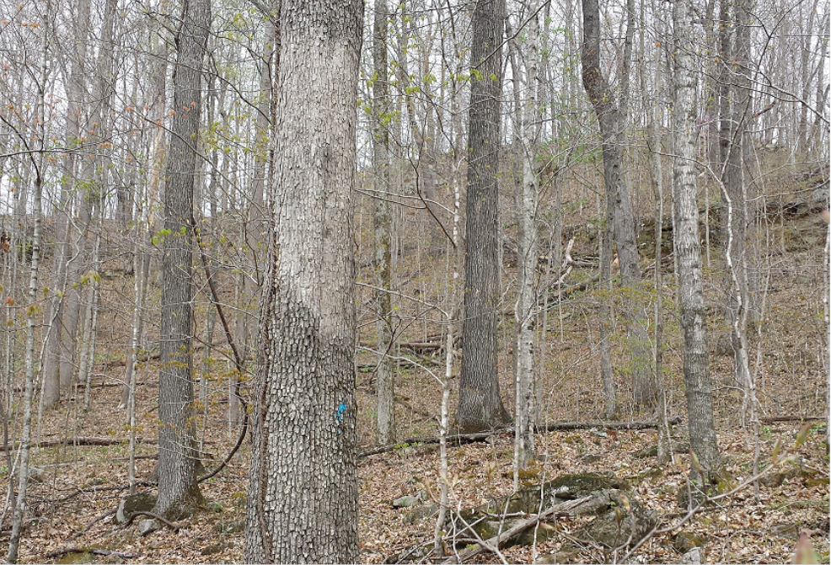
Coby Mosley
Office: 606-672-3856
Cell: 606-275-9921
Email: kfsr@tds.net
Timber Appraisals
Instructor:
Coby W. Mosley
Coby Mosley
Office: 606-672-3856
Cell: 606-275-9921
Email: kfsr@tds.net
Dick Brantigan
D&M Forestry

Slide 2
Introduction
Discussion Topics
Why need a timber appraisal
Stumpage Value
Approaches to Stumpage Value
Stumpage Value vs. Contributory Value

Slide 3
Stumpage Value
Stumpage Value- Value of logs delivered to the mill less logging/transportation costs.
Value a landowner receives for contracting the right for a logger to cut and remove his timber.
Determined by sales comparison or empirical method.

Slide 4
Stumpage Value Cont’d
Sales Comparison Approach-Timber Only
Competitive sealed-bid sales most reliable
Loggers/buyers sometimes pay landowner % of what is paid at mill/log yard in payments by contract when logs are delivered (very risky for landowner).
Timber sales rarely recorded in deed book.
Sale information obtained from consulting foresters or timber buyers.

Slide 5
Sales Comparison
Valuation Factors
MBF/acre (2.0 MBF/acre vs. 5.0 MBF/acre)
Market conditions (2008 market vs. 2014 market)
Distance to sawmill/log buying yard
Terrain
Difficulty logging
Access
Stand/tract quality (insect damage/fire damage/soils)
Species composition
Average diameter
Timber quality

Slide 6
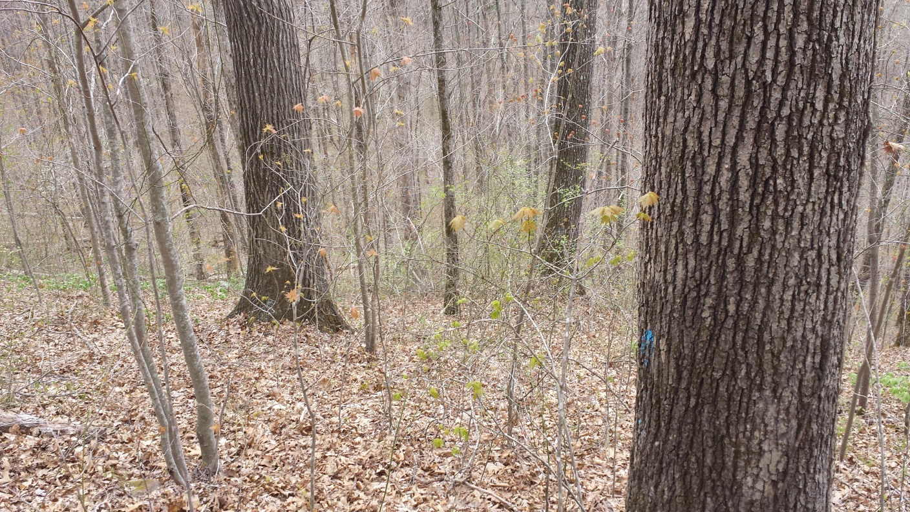


Sales Comparison Cont’d
Units of Comparison (timber only)
$/MBF
$/Board ft.
$/Ton (pulpwood)
$/Tandem load (local)
$/Tree (local/uncommon)
Stumpage Publication
James W. Sewall Company
Quarterly Stumpage Publication

Slide 7
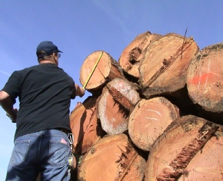
Delivered to the Mill Value
Mill Value- Is the price paid at the mill for logs.
Publications for delivered to the mill prices
KY Division of Forestry- Growing Gold
The Timber Market Report
Forest2Market
Timber Mart-South
US Forest Service
Local Sawmills/log buying yards

Slide 8
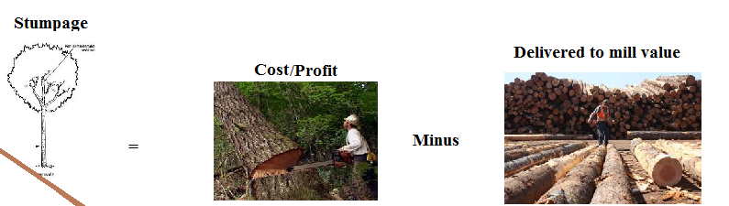
Conversion Return Approach
Stumpage value = Delivered to mill value – logging/delivery costs- entrepreneurial profit
Use published information, local information and determine estimated delivered value of stand/tract.
Talk to local foresters, timber sellers, buyers to determine logging cost/profit (percentage of total mill value) Varies based on timber quality or logging costs

Slide 9
Stumpage Value: is the amount a timber buyer will pay a landowner for the right to cut and remove timber in a competitive timber sale.
Contributory Timber Value: is the contribution that timber makes to the overall value of a tract of timberland (land and timber). Contributory value can be greater than, less than, or equal to the market value (Stumpage Value) of the timber. (Timber Valuation Morgan R. Mellette 2008)
Stumpage Value vs. Contributory Timber Value

Slide 10
The End

